Slide 1
Planning a Data Warehouse
Unit III Data ware house project plan
Sambhaji M Shedole

Slide 2
Contents
Stages of the Project –
The Planning Stage –
Justifying the Data warehouse - -
Overcoming Resistance to the Data warehouse-
Developing a Project Plan

Slide 3
Contents
Data warehousing Design Approaches –
The Architecture Stage –
The Data warehouse Data Base –
The Analysis Architecture –
Data warehouse Hard Ware.

Slide 4
Overview
Review the essentials of planning for a data warehouse
Distinguish between data warehouse projects and OLTP system projects
Learn how to adapt the life cycle approach for a data warehouse project
Introduce agile development methodology for DW projects
Discuss project team organization, roles, and responsibilities

Slide 5
Factors causing failures
Improper planning
Inadequate project management
Company not ready for a data warehouse
Insufficient staff training
Improper team management
No support from top management

Slide 6
Questions
Develop criteria for assessing the value expected from your data warehouse

Slide 7
Decide
  the type of data warehouse to be built
  where to keep the data warehouse
  where the data is going to come from
  whether you have all the needed data
  who will be using the data warehouse
  how they will use it
  at what times will they use it

Slide 8
Decisions
Decide
  the type of data warehouse to be built
  where to keep the data warehouse
  where the data is going to come from
  whether you have all the needed data
  who will be using the data warehouse
  how they will use it
  at what times will they use it

Slide 9











Key Issues
Value and Expectations
Risk Assessment
Top-Down or Bottom-Up
Build or Buy
Single Vendor or Best-of-Breed
Asses the value to be derived from the proposed data warehouse,
More than calculating the loss from the project costs
Plan and define overall requirements
Find the proper balance between in-house and vendor software.
High level of integration or products best suited for objectives
Take into account the opportunities that will be missed if there is NO data warehouse
Look at the pros and cons of these methods
Make a list of realistic benefits and expectations
Weight these options and document them
Notes:
Value and Expectations
jump into data warehousing and business intelligence projects without assessing the value to be derived from their proposed datawarehouse.
given the culture and the current requirements of your company, a data warehouse is the most viable solution.
Establish the suitability of this solution
enumerate the benefits and value propositions.
Will your data warehouse help the executives and managers to do better planning
and make better decisions?
Is it going to improve the bottom line?
Is it going to increase market share? If so, by how much?
What are the expectations?
What does the management want to accomplish through the data warehouse?
As part of the overall planning process,make a list of realistic benefits and expectations.
Risk Assessment
Planners generally associate project risks with the cost of the project.
If the project fails, how much money will go down the drain?
Assessment of risks is more than calculating the loss from the project costs.
What are the risks faced by the company without the benefits derivable from a data warehouse?
What losses are likely to be incurred? What opportunities are likely to be missed? Risk assessment is broad and relevant to each business.
Use the culture and business conditions of your company to assess the risks.
Include this assessment as part of your planning document.
Top-Down or Bottom-Up
top-down approach is to start at the enterprise-wide data warehouse, and possibly build it iteratively. Then data from the overall, large enterprise-wide data warehouse flows into departmental and subject data marts. On the other hand, the bottom-up approach is to start by building individual data marts, one by one. The conglomerate of these data marts will make up the enterprise data warehouse.
Do you have the large resources needed to build a corporate-wide data warehouse first and then deploy the individual data marts? This option may also take more time for implementation and delay the realization of potential benefits. But this option, by its inherent approach, will ensure a fully unified view of the corporate data.
It is possible that your company would be satisfied with quick deployment of a few data
marts for specific reasons. At this time, it may be important to just quickly react to some
market forces or ward off some fierce competitor. There may not be time to build an overall
datawarehouse. Or, you may want to examine and adopt the practical approach of conformed
data marts.Whatever approach yourcompany desires to adopt, scrutinize the options carefully
and make the choice. Document the implications of the choice in the planning document.
Build or Buy
No one builds a data warehouse totally from scratch by in-house programming. There is no need to reinvent the wheel everytime. A wide and rich range of third-party tools and solutions are available. After nearly a decade of the data warehousing movement the market has matured, with suitable tools for data warehousing and business intelligence.
The real question is how much of your data marts should you build yourselves? How much of these may be composed of ready-made solutions? What type of mix and match must be done?
In a data warehouse, there is a large range of functions. Do you want to write more inhouse
programs for data extraction and data transformation? Do you want to use in-house
programs for loading the data warehouse storage? Do you want to use vendor tools completely
for information delivery and business intelligence? You retain control over the
functions wherever you use in-house software. On the other hand, the buy option could
lead to quick implementation if managed effectively.
Be wary of the marts-in-the-box or the 15-minute data marts. There are no silver bullets
out there. The bottom line is to do your homework and find the proper balance between
in-house and vendor software. Do this at the planning stage itself.
Single Vendor or Best-of-Breed Vendors come in a variety of categories. There are
multiple vendors and products catering to the many functions of the datawarehouse.
Options? How to decide?
to use the products of a single vendor,
to use products from more than one vendor, selecting appropriate tools.
Choosing a single vendor solution has a few advantages:
† High level of integration among the tools
† Constant look and feel
† Seamless cooperation among components
† Centrally managed information exchange
† Negotiable overall price
This approach will naturally enable your data warehouse to be well integrated and function
coherently. However, only a few vendors such as IBM and NCR offer fully integrated
solutions.
Reviewing this specific option further, here are the major advantages of the best-of-breed
solution that combines products from multiple vendors:
† You can build an environment to fit your organization.
† There is no need to compromise between database and support tools.
† You can select products best suited for the specific function.
With the best-of-breed approach, compatibility among the tools from the different vendors
could become a serious problem. If you are taking this route, make sure the selected
tools are proven to be compatible. In this case, the staying power of individual vendors is
crucial. Also, you will have less bargaining power with regard to individual products and
may incur higher overall expense. Make a note of the recommended approach: have one
vendor for the database and the information delivery functions, and pick and choose other
vendors for the remaining functions. However, the multivendor approach is not advisable
if your environment is not heavily technical.
Business Requirements, Not Technology
Let business requirements drive your data warehouse, not technology. Although this seems
so obvious, you would not believe how many data warehouse projects grossly violate this
maxim. Many data warehouse developers are interested in putting pretty pictures on the
user’s screen and pay little attention to the real requirements. They like to build snappy
systems exploiting the depths of technology and merely demonstrating their prowess in
harnessing the power of technology.
Remember, data warehousing is not about technology, it is about solving users’ need for
strategic information. Do not plan to build the data warehouse before understanding the
requirements. Start by focusing on what information is needed and not on how to provide
the information. Do not emphasize the tools. Tools and products come and go. The basic
structure and the architecture to support the user requirements are more important.
So before making the overall plan, conduct a preliminary survey of requirements. How do
you do that? No details are necessary at this stage. No in-depth probing is needed. Just try to
understand the overall requirements of the users. Your intention is to gain a broad understanding
of the business. The outcome of this preliminary survey will help you formulate
the overall plan. It will be crucial to set the scope of the project. Also, it will assist you in
prioritizing and determining the rollout plan for individual data marts. For example, you
single vendor, or to use products from more than one vendor, selecting appropriate tools.
Choosing a single vendor solution has a few advantages:
† High level of integration among the tools
† Constant look and feel
† Seamless cooperation among components
† Centrally managed information exchange
† Negotiable overall price
This approach will naturally enable your data warehouse to be well integrated and function
coherently. However, only a few vendors such as IBM and NCR offer fully integrated
solutions.
Reviewing this specific option further, here are the major advantages of the best-of-breed
solution that combines products from multiple vendors:
† You can build an environment to fit your organization.
† There is no need to compromise between database and support tools.
† You can select products best suited for the specific function.
With the best-of-breed approach, compatibility among the tools from the different vendors
could become a serious problem. If you are taking this route, make sure the selected
tools are proven to be compatible. In this case, the staying power of individual vendors is
crucial. Also, you will have less bargaining power with regard to individual products and
may incur higher overall expense. Make a note of the recommended approach: have one
vendor for the database and the information delivery functions, and pick and choose other
vendors for the remaining functions. However, the multivendor approach is not advisable
if your environment is not heavily technical

Slide 10
Value and Expectations
  Asses the value to be derived from the proposed data warehouse,
  Make a list of realistic benefits and expectations
Risk Assessment
  More than calculating the loss from the project costs
  Take into account the opportunities that will be missed if there is NO data warehouse
Top-Down or Bottom-Up
  Plan and define overall requirements
  Look at the pros and cons of these methods
  Weight these options and document them
Build or Buy
  Find the proper balance between in-house and vendor software.
Single Vendor or Best-of-Breed
  High level of integration or products best suited for objectives

Slide 11
Driving Force
Business Requirements, Not Technology
Understand the requirements
Focus on
  user’s needs
  Data needed
  How to provide information
Use a preliminary survey to gather general requirements before planning

Slide 12
Preliminary Survey
Mission and functions of each user group
Computer systems used by the group
Key performance indicators
Factors affecting success of the user group
Who the customers are and how they are classified
Types of data tracked for the customers, individually and as groups
Products manufactured or sold
Categorization of products and services
Locations where business is conducted
Levels at which profits are measured—per customer, per product, per district
Levels of cost details and revenue
Current queries and reports for strategic information
Notes:
As part of the preliminary survey, include a source system audit. Even at this stage, you
must have a fairly good idea from where the data is going to be extracted for the data warehouse.
Review the architecture of the source systems. Find out about the relationships among
the data structures. What is the quality of the data? What documentation is available? What
are the possible mechanisms for extracting the data from the source systems? Your overall
plan must contain information about the source systems.

Slide 13
Justification
Calculate the current technology costs to produce the applications and reports supporting strategic decision making. Compare this with the estimated costs for the data warehouse and find the ratio between the current costs and proposed costs. See if this ratio is acceptable to senior management.
Calculate the business value of the proposed data warehouse with the estimated dollar values for profits, dividends, earnings growth, revenue growth, and market share growth. Review this business value expressed in dollars against the data warehouse costs and come up with the justification.
Do the full-fledged exercise. Identify all the components that will be affected by the proposed data warehouse and those that will affect the data warehouse. Start with the cost items, one by one, including hardware purchase or lease, vendor software, in-house software, installation and conversion, ongoing support, and maintenance costs. Then put a dollar value on each of the tangible and intangible benefits, including cost reduction, revenue enhancement, and effectiveness in the business community.

Slide 14
Challenges for Data Warehousing Project Management
DATA ACQUISITION
DATA STORAGE
INFO. DELIVERY
Large number of sources
Many disparate sources
Different computing
platforms
Outside sources
Huge initial load
Ongoing data feeds
Data replication considerations
Difficult data integration
Complex data transformations
Data cleansing
Storage of large data
volumes
Rapid growth
Need for parallel
processing
Data storage in staging area
Multiple index types
Several index files
Storage of newer data types
Archival of old data
Compatibility with tools
RDBMS & MDDBMS
Several user types
Queries stretched to limits
Multiple query types
Web-enabled
Multidimensional analysis
OLAP functionality
Metadata management
Interfaces to DSS apps.
Feed into Data Mining
Multi-vendor tools

Slide 15
Cope with differences in Data Warehousing Projects
Recognize that a data warehouse project
  has broader scope,
  tends to be more complex, and
  Involves many different technologies.
Do not hesitate to find and use specialists wherever in-house talent is not available.
  A data warehouse project has many out-of-the-ordinary tasks.
Metadata in a data warehouse is so significant that it needs special treatment throughout the project.
  Pay extra attention to building the metadata framework properly.
  to build and complete the infrastructure.
  to decide on the architecture design.
  for the evaluation and selection of tools.
  for training the users in the query and reporting tools.
Involve the users in every stage of the project. Data warehousing could be completely new to both IT and the users in your company. A joint effort is imperative.
Allow sufficient time Because of the large number of tasks in a data warehouse project, parallel development tracks are absolutely necessary. Be prepared for the challenges of running parallel tracks in the project life cycle.

Slide 16
Readiness Assesment Report
Purpose of Assesment Report
The project manager performs assessment
with the assistance of an outside expert.
Lower the risks of big surprises occurring during implementation
Provide a proactive approach to problem resolution
Reassess corporate commitment
Review and reidentify project scope and size
A formal readiness assessment report before the project
plan is prepared
Identify critical success factors
Restate user expectations
Ascertain training needs

Slide 17
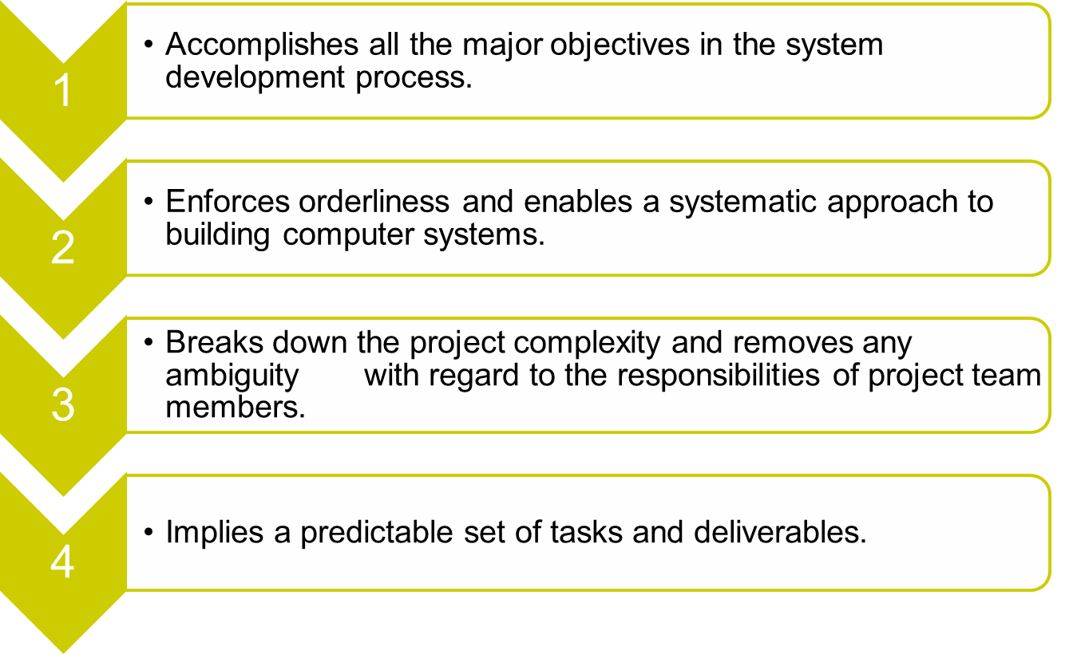
Advantages of the life cycle approach

Slide 18
Life Cycle Approach
The life cycle approach breaks down the project complexity
A one-size-fits-all life cycle approach will not work for a data warehouse project.
The approach for a data warehouse project has to include iterative tasks going through cycles of refinement.

Slide 19
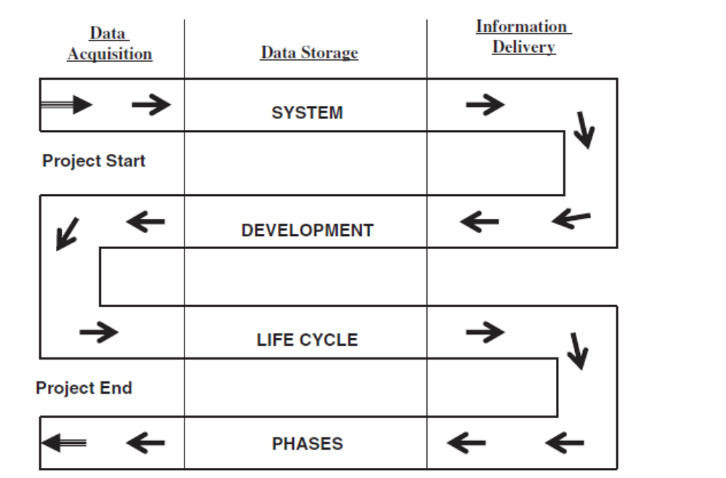
System Development Life Cycle for data warehousing
Notes:
For example, if one of your tasks in the project is identification of
data sources, you might begin by reviewing all the source systems and listing all the source data structures. The next iteration of the task is meant to review the data elements with the users. You move on to the next iteration of reviewing the data elements with the database administrator and some other IT staff. The next iteration of walking through the data elements one more time completes the refinements and the task. This type of iterative process is required for each task because of the complexity and broad scope of the project.

Slide 20
Sample Outline of a Project Plan
INTRODUCTION
PURPOSE
ASSESSMENT OF READINESS
GOALS & OBJECTIVES
STAKEHOLDERS
ASSUMPTIONS
CRITICAL ISSUES
SUCCESS FACTORS
PROJECT TEAM
PROJECT SCHEDULE
DEPLOYMENT DETAILS
Notes:
As in any system development life cycle, the data warehouse project begins with the preparation of a project plan. The project plan describes the project, identifies the specific objectives, mentions the crucial success factors, lists the assumptions, and highlights the critical issues. The plan includes the project schedule, lists the tasks and assignments, and provides for monitoring progress. Figure 4-4 provides a sample outline of a data warehouse project plan

Slide 21
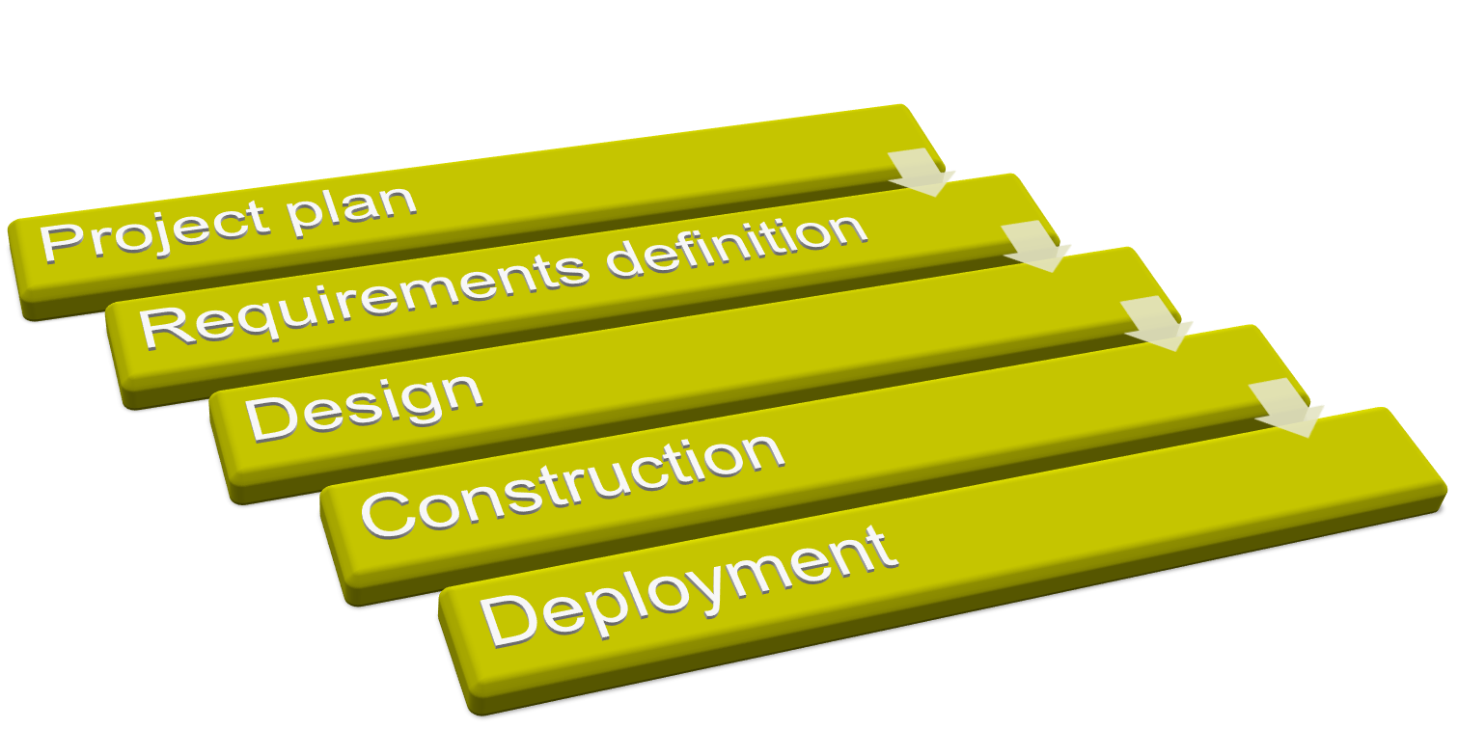
DEVELOPMENT Phases

Slide 22
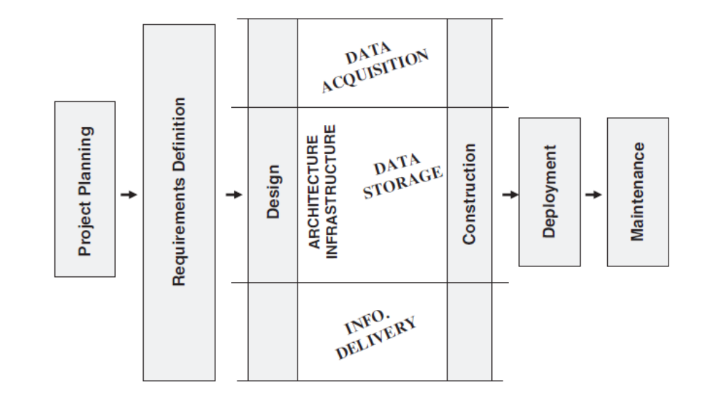

Development Phases
The design phase and construction phase for these three components of DW may run in parallel.
The phases must include tasks
  to define the architecture as composed of the three components of DW
  and to establish the underlying infrastructure to support the architecture.
Notes:
Interwoven within the design and construction phases are the three tracks along with the definition of the architecture and the establishment of the infrastructure. Each of the boxes shown in the diagram represents a major activity to be broken down further into individual tasks and assigned to the appropriate team members. Use the diagram as a guide for listing the activities and tasks for your data warehouse project. Although the major activities may remain the same for most warehouses, the individual tasks within each activity are likely to vary for your specific data warehouse.

Slide 23

What is Agile Development
Based on iterative development
  Requirements and solutions evolve through collaboration between self-organizing cross-functional teams
Receive Feedback
Client Tests
Code/Design
Deliver Alpha

Slide 24
Agile Development
Core Values
  striving for simplicity and not being bogged down in complexity, providing and obtaining constant feedback on individual development tasks, fostering free and uninhibited communication, and rewarding courage to learn from mistakes.
Core Principles
  encouraging quality, embracing change, changing incrementally, adopting simplicity, and providing rapid feedback.
Core Practices
  creating short releases of application components, performing development tasks jointly , working the 40-hour work week intensively, not expanding the time for ineffective pursuits, and having user representatives on site with the project team.
Variables
  Control variables that can be manipulated for trade-offs to achieve results are time, quality, scope, and cost.

Slide 25
Project Team
Caution!
  Complexity overload
  Responsibility Ambiguity
List all the project challenges and specialized skills needed.
  planning,
  defining data requirements,
  defining types of queries,
  data modeling,
  tools selection,
  physical database design,
  source data extraction,
  data validation and quality control,
  setting up the metadata framework,
  . . .
Using the list of challenges and skills prepare a list of team roles needed to support the development work.
  assign individual persons to the team roles with the right abilities, suitable skills and the proper work experience.
Notes:
Two things can break a project: complexity overload and responsibility ambiguity. In a life cycle approach, the project team minimizes the complexity of the effort by sharing and performing. When the right person on the team, with the right type of skills and with the right level of experience, does an individual task, this person is really resolving the complexity issue.

Slide 26
Organizing the Project Team
Not necessary to assign one or more persons to each of the identified roles.
If the data warehouse effort is not large and your company’s resources are meager, try making the same person wear many hats
Remember that the user representatives must also be considered as members of the project team.
Do not fail to recognize the users as part of the team and to assign them to suitable roles.
Important properties of team members :
Skills, experience, and knowledge
attitude, team spirit,
passion for the data warehouse effort,
strong commitment

Slide 27
Classification of Roles in the Project Team
Data warehousing authors classify the roles or job titles in various ways. They first come up with broad classifications and then include individual job titles within these classifications.
Staffing for
  initial development,
  testing,
  ongoing maintenance,
  data warehouse management
IT and end-users,
  Subclassifications
    further subclassifications
Front office roles, back office roles
Coaches, regular lineup, special teams
Management, development, support
Administration, data acquisition, data storage, information delivery
Notes:
Data warehousing authors and practitioners tend to classify roles or job titles in various ways. They first come up with broad classifications and then include individual job titles within these classifications. Here are some of the classifications of the roles:

Slide 28
Job Titles in the Project Team
Executive Sponsor
Project Director
Project Manager
User Representative Manager
Data Warehouse Administrator
Organizational Change Manager
Database Administrator
Metadata Manager
Business Requirements Analyst
Data Warehouse Architect
Data Acquisition Developer
Data Access Developer
Data Quality Analyst
Data Warehouse Tester
Maintenance Developer
Data Provision Specialist
Business Analyst
System Administrator
Data Migration Specialist
Data Grooming Specialist
Data Mart Leader
Infrastructure Specialist
Power User
Training Leader
Technical Writer
Tools Specialist
Vendor Relations Specialist
Web Master
Data Modeler
Security Architect

Slide 29
Some Team Roles
Executive sponsor
Project manager
User liaison manager
Lead architect
Infrastructure specialist
Business analyst
Data modeler
Data warehouse administrator
Data transformation specialist
Quality assurance analyst
Testing coordinator
End-user applications specialist
Development programmer
Lead trainer

Slide 30
Roles and Responsibilities of a Project Team
Executive Sponsor
  Direction, support, arbitration.
Project Manager
  Assignments, monitoring, control.
User Liaison Manager
  Coordination with user groups.
Lead Architect
  Architecture design.
Infrastructure Specialist
  Infrastructure design/construction.
Business Analyst
  Requirements definition.
Data Modeler
  Relational and dimensional modeling.
Data Warehouse Administrator
  DBA functions.
Data Transformation Specialist
  Data extraction, integration, transformation.
Quality Assurance Analyst
  Quality control for warehouse data.
Testing Coordinator
  Program, system, tools testing.
End-User Applications Specialist
  Confirmation of data meanings/relationships.
Development Programmer
  In-house programs and scripts.
Lead Trainer
  Coordination of User and Team training.

Slide 31
Roles and Responsibilities of a Project Team
Executive Sponsor
  Direction, support, arbitration.
Data Warehouse Administrator
  DBA functions.
Project Manager
Data Transformation Specialist
  Data extraction, integration, transformation.
  Assignments, monitoring, control.
Quality Assurance Analyst
  Quality control for warehouse data.
User Liaison Manager
  Coordination with user groups.
Testing Coordinator
  Program, system, tools testing.
Lead Architect
  Architecture design.
End-User Applications Specialist
  Confirmation of data meanings/relationships.
Infrastructure Specialist
  Infrastructure design/construction.
Development Programmer
  In-house programs and scripts.
Business Analyst
  Requirements definition.
Lead Trainer
  Coordination of User and Team training.
Data Modeler
  Relational and dimensional modeling.

Slide 32
Roles and skills/experience levels required in the Project Team
Executive Sponsor
Project Manager
User Liaison Manager
Lead Architect
  Senior level executive,
  in-depth knowledge of the business,
  enthusiasm and ability to moderate and arbitrate as necessary.
  People skills,
  project management experience,
  business and user oriented,
  ability to be practical and effective.
  People skills,
  respected in user community,
  organization skills,
  team player,
  knowledge of systems from user viewpoint.
  Analytical skills,
  ability to see the big picture,
  expertise in interfaces,
  knowledge of data warehouse concepts.
Infrastructure Specialist
Business Analyst
Data Modeler
  Specialist in hardware, operating systems, computing platforms,
  experience as operations staff.
  Analytical skills,
  ability to interact with users,
  sufficient industry experience as analyst.
  Expertise in relational and dimensional modeling with case tools,
  experience as data analyst.

Slide 33
Roles and skills/experience levels required in the Project Team
Data Warehouse Administrator
Data Transformation Specialist
Quality Assurance Analyst
  Expert in physical database design and implementation,
  Experience as relational DBA,
    MDDBMS experience a plus.
  Knowledge of data structures,
  in-depth knowledge of source systems,
  experience as analyst.
  Knowledge of data quality techniques,
  knowledge of source systems data,
  experience as analyst.
Testing Coordinator
  Familiarity with testing methods and standards,
  use of testing tools,
  knowledge of some data warehouse information delivery tools,
  experience as programmer/analyst.
End-User Applications Specialist
Development Programmer
Lead Trainer
  In-depth knowledge of source applications.
  Programming and analysis skills,
  experience as programmer in selected language and DBMS.
  Training skills,
  experience in IT/User training,
  coordination and organization skills.

Slide 34
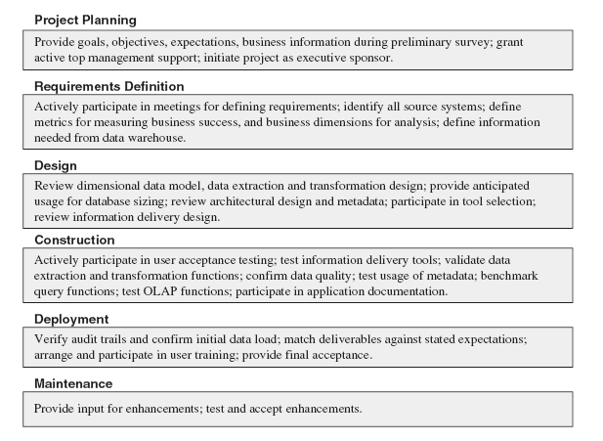
Participation of the user in Data warehousing life cycle
Notes:
Project Planning
Requirements Definition
Design
Construction
Deployment
Maintenance
Provide goals, objectives, expectations, business information during preliminary survey; grant
active top management support; initiate project as executive sponsor.
Actively participate in meetings for defining requirements; identify all source systems; define
metrics for measuring business success, and business dimensions for analysis; define information
needed from data warehouse.
Review dimensional data model, data extraction and transformation design; provide anticipated
usage for database sizing; review architectural design and metadata; participate in tool selection;
review information delivery design.
Actively participate in user acceptance testing; test information delivery tools; validate data
extraction and transformation functions; confirm data quality; test usage of metadata; benchmark
query functions; test OLAP functions; participate in application documentation.
Verify audit trails and confirm initial data load; match deliverables against stated expectations;
arrange and participate in user training; provide final acceptance.
Provide input for enhancements; test and accept enhancements.

Slide 35
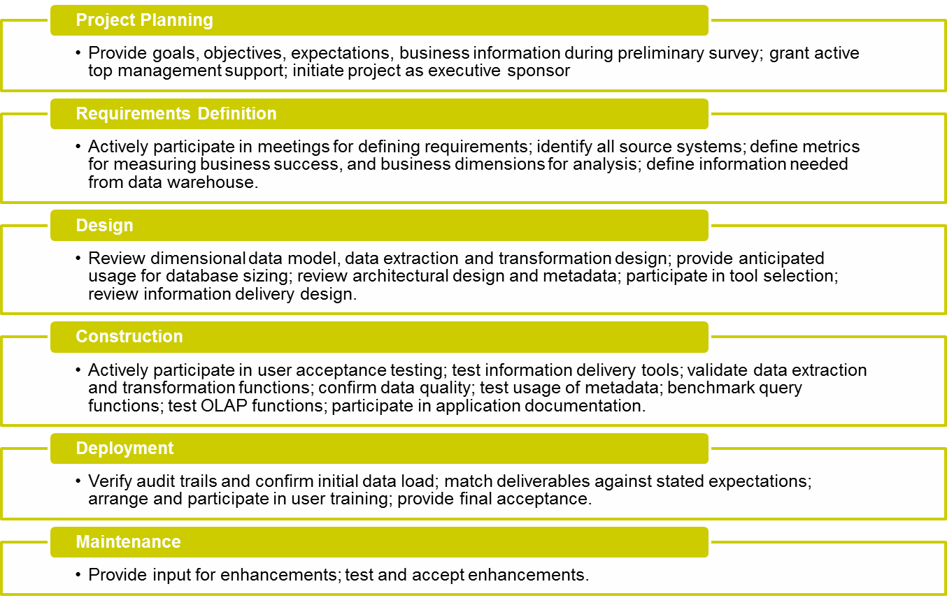
User Participation in DW Development

Slide 36
Team Roles for Users
Project sponsor
  responsible for supporting the project effort all the way (must be an executive)
User department liaison representatives
  help IT to coordinate meetings and review sessions and ensure active participation by the user departments
Subject area experts
  provide guidance in the requirements of the users in specific subject areas and clarify semantic meanings of business terms used in the enterprise
Data review specialists
  review the data models prepared by IT; confirm the data elements and data relationships
Information delivery consultants
  examine and test information delivery tools; assist in the tool selection
User support technicians
  act as the first-level, front-line support for the users in their respective departments

Slide 37
Team Roles for Users
Project sponsor
  responsible for supporting the project effort all the way
  must be an executive
User department liaison representatives
  help IT to coordinate meetings and review sessions
  ensure active participation by the user departments
Subject area experts
  provide guidance in the requirements of the users in specific subject areas
  clarify semantic meanings of business terms used in the enterprise
Data review specialists
  review the data models prepared by IT
  confirm the data elements and data relationships
Information delivery consultants
  examine and test information delivery tools;
  assist in the tool selection
User support technicians
  act as the first-level,
  front-line support for the users in their respective departments

Slide 38
Project Management Considerations
The effort of data warehouse project has been successful if there is critical effective project management.
Project management issues are applied to build success data warehouse projects :
  project management principles,
  warning signs,
  success factors,
  adopting a practical approach,.

Slide 39
Project Management Considerations:
Guiding Principles.
Some of the guiding principles that pertain to
data warehouse projects exclusively :
  Project Manager
  Team Roles
  User Requirements
  Training
  Realistic Expectations
  External Data
  Sponsorship
  New Paradigm
  Data Quality
  Building for Growth
  Project Politics
  Dimensional Data Modeling

Slide 40
Project Management Considerations:
Adopt a Practical Approach.
A practical approach is simply a common-sense approach that has a nice blend of practical wisdom and hard-core theory.
While using a practical approach, you are totally results-oriented, and you are not driven by technology, you are motivated by business requirements.

Slide 41
WARNING SIGN INDICATION ACTION
Users not cooperating
to provide details of
data.
Possible turf concerns
over data ownership.
Very delicate issue. Work with
executive sponsor to resolve the
issue.
Users not comfortable
with the query tools.
Users not trained
adequately.
First, ensure that the selected
query tool is appropriate. Then
provide additional training.
Continuing problems
with data brought over
to the staging area.
Data transformation and
mapping not complete.
Revisit all data transformation
and integration routines. Ensure
that no data is missing. Include
the user representative in the
verification process

Slide 42
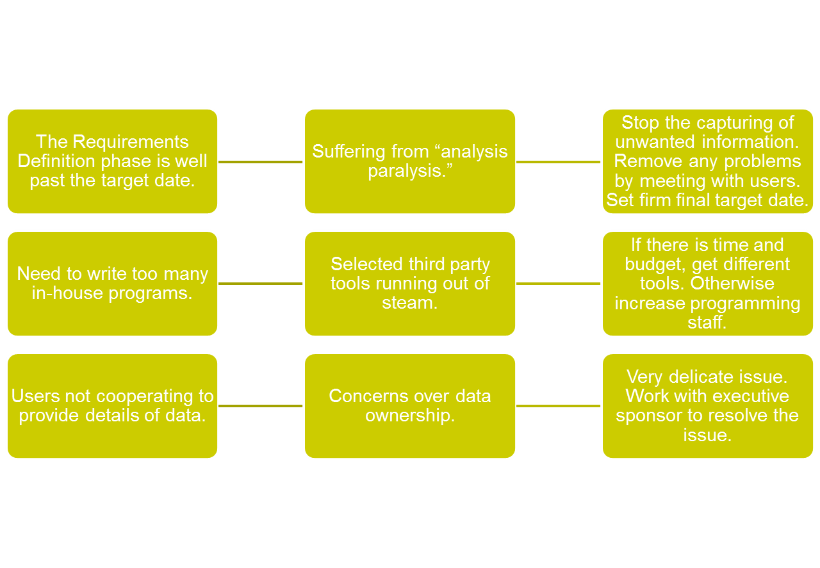
WARNING SIGN INDICATING ACTION

Slide 43
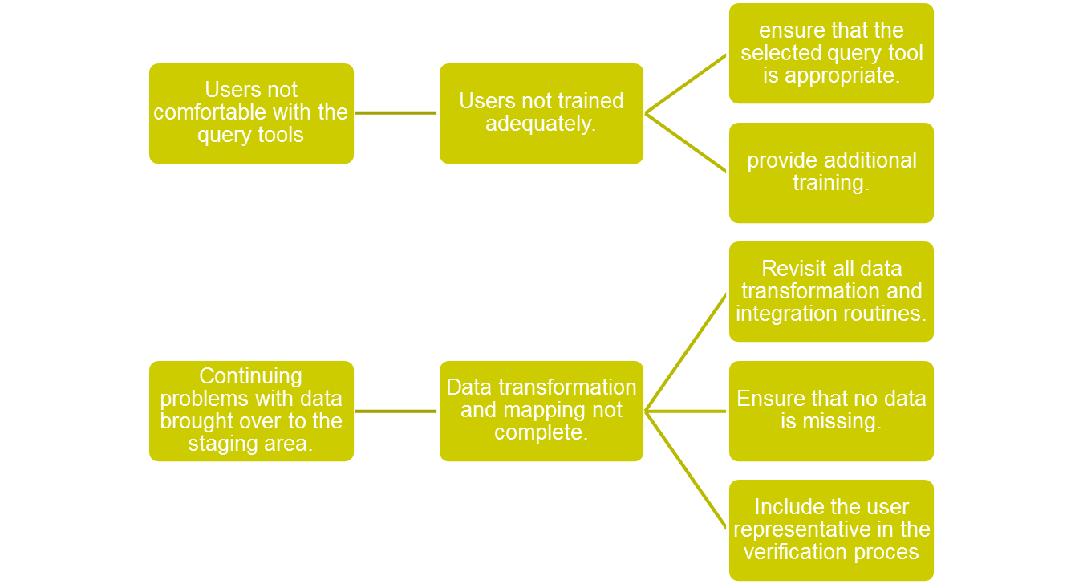
WARNING SIGN INDICATING ACTION

Slide 44
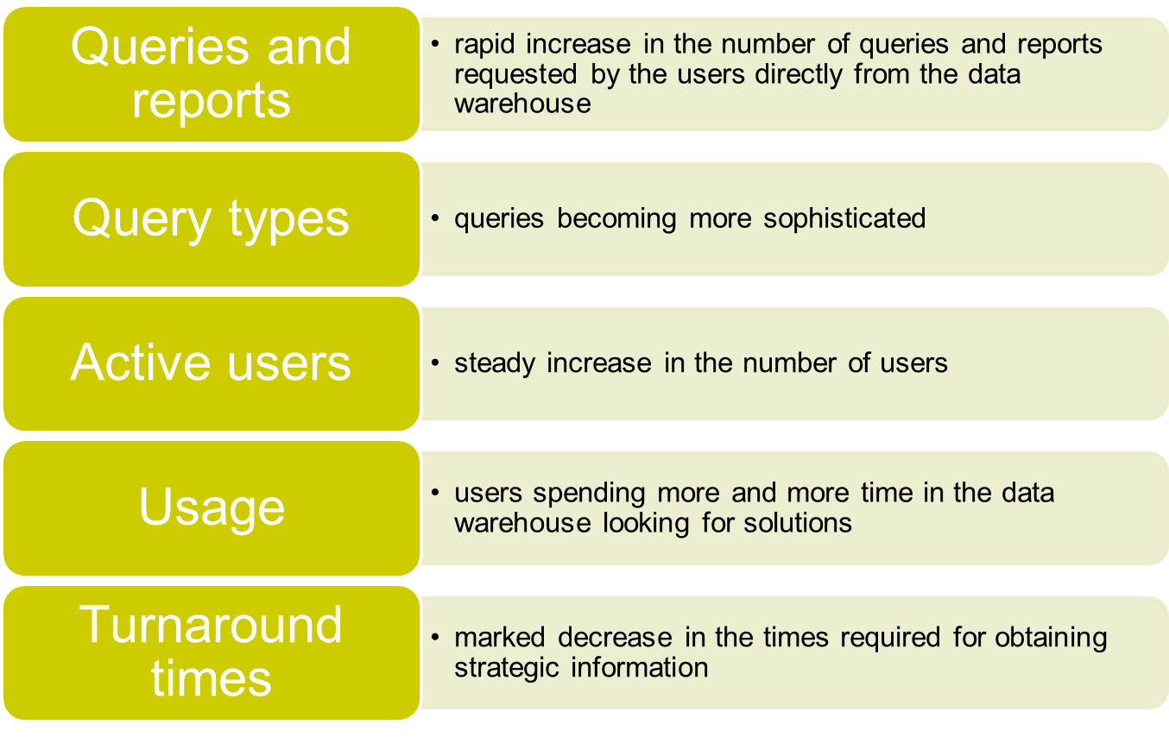
Indications of Success

Slide 45


